Slide 1


Deep Learning
Class 4

Slide 2
RNN
specifically designed to handle sequential data
current input depends not only on the current time step but also on previous inputs
maintains hidden states that store information about past inputs
Hidden State: Represents the memory of the network and is updated at each time step.

Slide 3
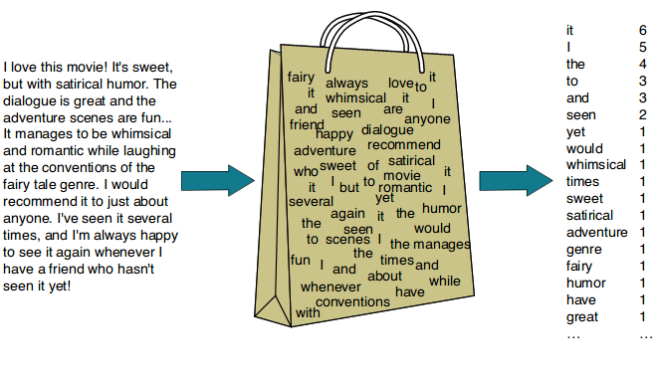

Slide 4
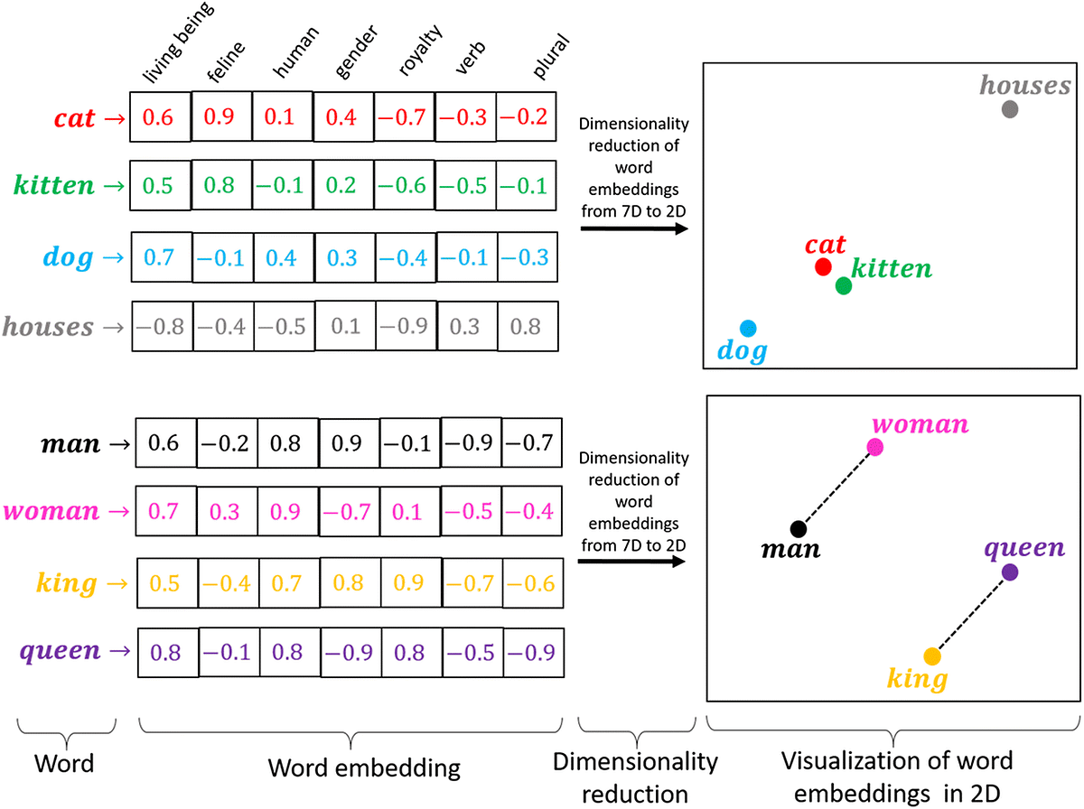

Slide 5
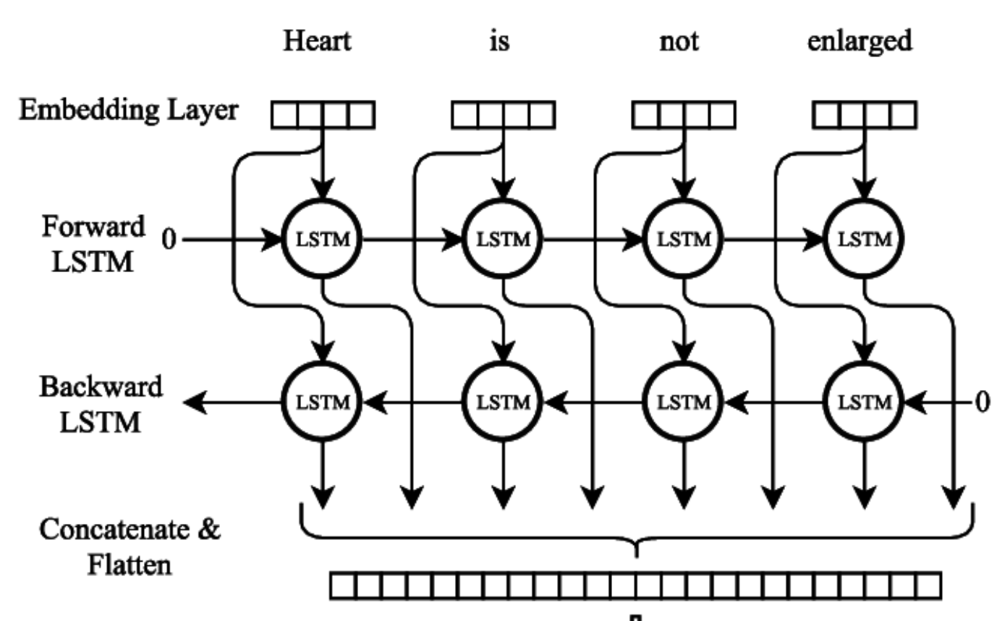

Slide 6
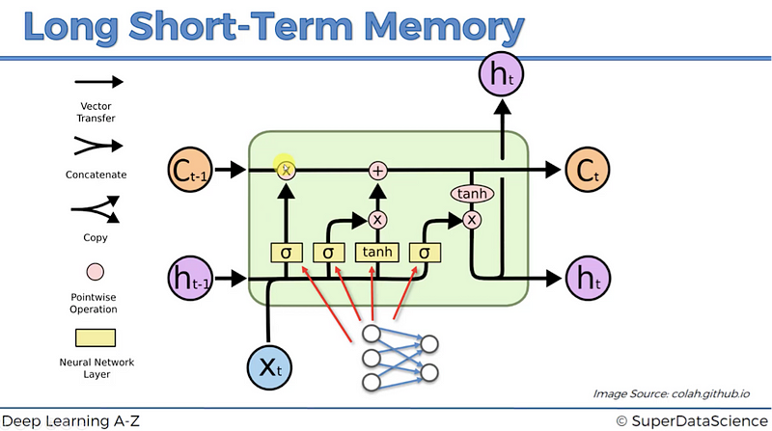

Slide 7
